Slide 1
Linking Latin Philosophical Expressions
Giovanna Tonazzo
Notes:
ID=d924773e-9a16-4d6d-9803-8cb819e99682 Recipe=text_billboard Type=TextOnly Variant=0 FamilyID=AccentBoxWalbaum_Zero

Slide 2
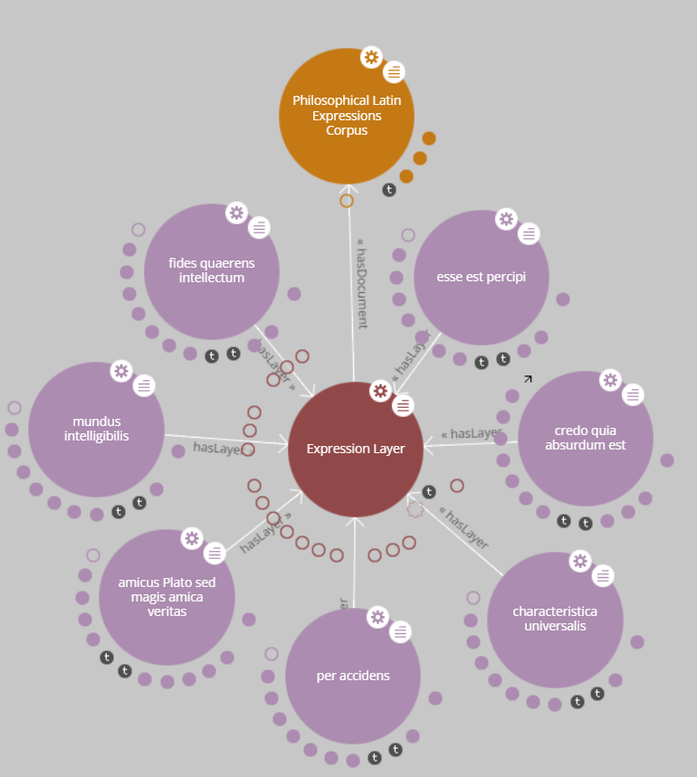
Agenda
Motivation
Methodology
Results
Data and code are available on GitHub

Slide 3
Motivation

Slide 4
Latin philosophical expressions
Latin expressions like “cogito, ergo sum” or “homo homini lupus” are found in nearly every philosophy manual. These expressions are often:
Central to a philosopher's worldview
Full phrases or sentences, not just isolated words
Rarely covered comprehensively in standard dictionaries
Philosophy students sometimes lack a strong background in Latin, and may find it difficult to:
Grasp literal meanings of these expressions
Understand their grammatical structures
Connect their linguistic form with philosophical content

Slide 5
This project is inspired by a resource created by Prof. James Lesher — a curated collection of Latin philosophical expressions. Each expression in the collection includes:
A literal translation into English
Linguistic analysis (parts of speech, case, syntax)
A philosophical explanation, often linked to thinkers like Aristotle, Descartes, or Kant
Examples and context from historical texts
Examples of Latin expressions from the collection
A posteriori: preposition + the ablative neuter singular of the comparative adjective posterior/posteriorus (literally: ‘from the later thing’): things known a posteriori are known on the basis of experience (e.g. ‘We can know only a posteriori that all swans are white’).
A priori: preposition + the ablative neuter singular of the comparative adjective prior/prius (literally: ‘from the earlier thing’): what is known to be true a priori can be known independently of (or prior to) empirical investigation or confirmation (e.g. ‘Kant held that we can know a priori that a straight line is the shortest distance between two points.’)
Amicus Plato sed magis amica veritas: ‘Plato is a friend but truth is a greater friend’, based loosely on Aristotle, Nicomachean Ethics 1096a.

Slide 6
Can this resource be improved?
This resource is very useful for students, but it has some limitations:
It gives a short definition of each expression, but many of them have been interpreted in different ways by different thinkers. Expanding the entries to indicate key philosophical interpretations would help student develop a critical understanding of concepts.
When philosophers are mentioned, it does not provide direct links or references to their works or biographical information. Adding these connections would make it easier for students to place the terms in their proper philosophical context.
Some entries are related (i.e “a priori” and “a posteriori”) but these relationships are not explicitly indicated in the document. Making these connections visible would help students understand the logical and conceptual relationships among terms.

Slide 7
Can this resource be improved?
This resource exists in a relatively isolated form. Publishing it as linked data by integrating it with existing ontologies or connecting entries to structured resources like Wikidata would significantly enrich its role as a resource for philosophical study.
This would allow students to situate each term within a broader conceptual and historical network, and to explore philosophical concepts across languages and interpretations more effectively.
Linking terms, expressions, and philosopher names to external sources would transform the resource from a static glossary into a dynamic, interoperable tool for philosophical study and research.

Slide 8
Methodology

Slide 9
Steps taken to enrich the resource (1)
Converted the original textual content into a structured format (CSV).
Included additional expressions (e.g., homo homini lupus); the final version is not fully aligned with Prof. Lesher’s original collection.
Provided more extensive definitions (with the help of ChatGPT – see notebook) to clarify the general philosophical concepts.
Classified expressions by branch of philosophy (e.g., epistemology, ethics, logic).
Included alternative interpretations from different philosophers.

Slide 10
Steps taken to enrich the resource (2)
Linked expressions, philosophers, and philosophical branches to external resources (Wikidata).
Created internal links between related expressions (e.g., a priori and a posteriori, res cogitans and res extensa).
Performed grammatical analysis (tokenization, part of speech tagging, morphological features, dependency relations) following the Universal Dependencies framework, linking definitions from official UD documentation pages.
Linked Latin lemmas to the LiLa “Linking Latin” knowledge base.
Published as linguistic linked data (triplestore in Turtle format).

Slide 11
Tools used
OpenRefine for reconciliation with Wikidata page of entry, philosopher, branch of philosophy.
Custom Python procedures
to call LiLa TextLinker (see notebook).
to call UDPipe API for annotation.
to generate the triplestore using RDFLib (see notebook).
Apache Jena Fuseki and LodLive for visualization.
Basic SPARQL queries for analysis.

Slide 12
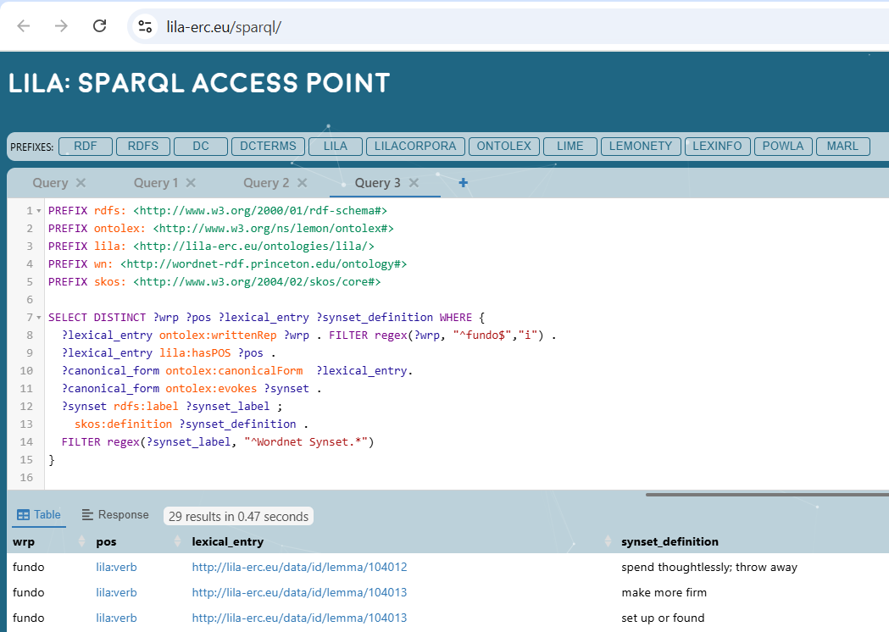
Linking to LiLa
Problems:
No matches: solved by manual search in Lemma Bank query interface
More than one match: ambiguity resolved with a SPARQL query to go from lemma to Wordnet Synset to clarify meaning

Slide 13
Input data for Turtle file
CSV files for entries and interpretations
JSON file for LiLa links
Manually curated list of linked concepts
Response in CoNLL-U format returned by UDPipe (using model “latin-evalatin24-240520”)

Slide 14
Modeling
I considered the resource both as a corpus and as a lexical resource.
Considering it as a corpus, I modeled it using POWLA. This allowed a modular approach that made possible to distinguish between content layers and annotation layers. For the syntactic annotation, I used also Web Annotation.
Content layers:
Each expression is a root that belongs to the Expression Layer
The tokens are terminals in the Document Layer
Annotation layers:
Dependency Annotation Layer contains the syntactic dependency relations
UD Annotation Layer contains POS and morphological features
Semantic Annotation Layer to connect entry to its general meaning

Slide 15
Modeling
Considering the collection as a lexical resource, I modeled it using ONTOLEX.
LIME lexicons
Separate LIME lexicons for Latin and English
Each Latin expression is a lexical entry in the Latin lexicon
The corresponding English translation is an entry in the English lexicon
VARTRANS translation
The translation is a relation between Latin and English lexical entries
The relation is reified and it is of category “philosophicalTranslation”

Slide 16
Modeling
Semantics
General concept modeled as lexical concept evoked by the lexical entry (both Latin and English lexical entry evoke the same concept)
The lexical concept has a SKOS definition and link to Wikidata page
Branch of philosophy linked to lexical concept as broader concept
Relations between expressions (i.e. “a priori” and “a posteriori”) as relations between lexical concepts
Specific interpretations by different philosophers as different senses, linked to the general concept via SKOS narrower relation
Philosopher are connected to the sense and to the lexical concept as dc:creator

Slide 17
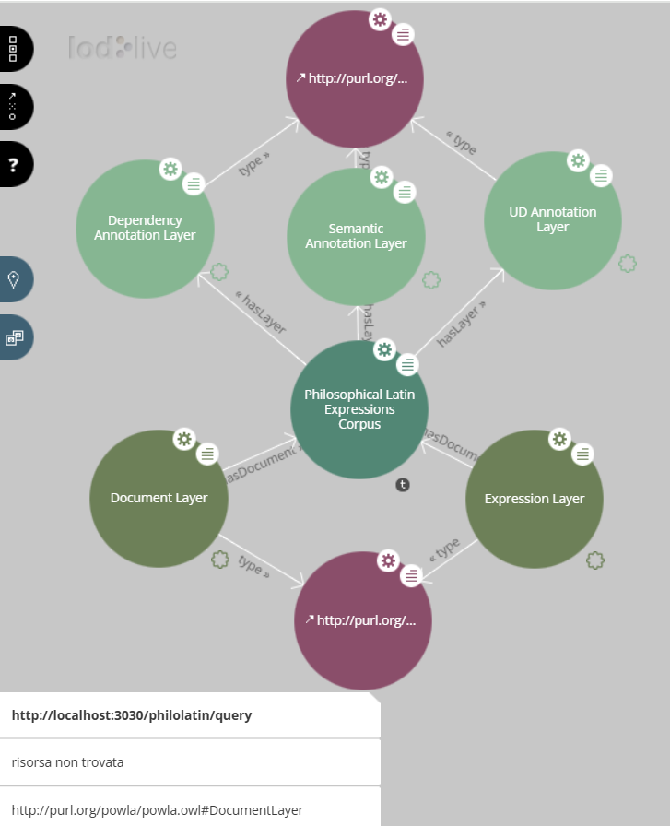
POWLA corpus
Content Layers
Annotation Layers

Slide 18
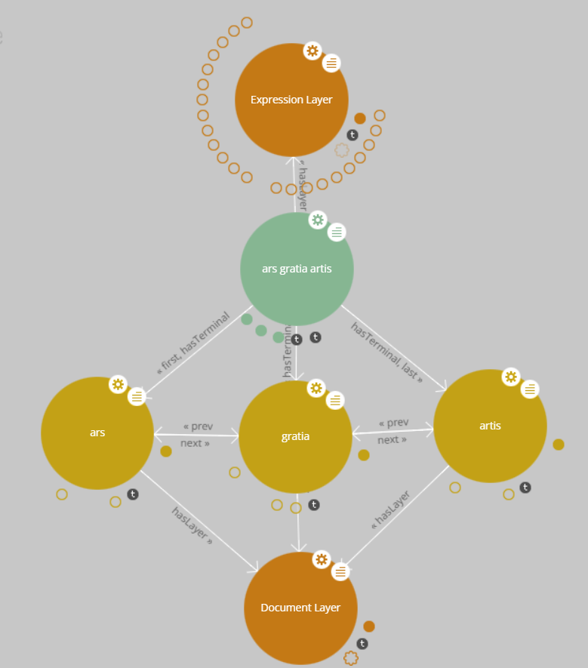
Content Layers
Expression Layer: expressions as POWLA roots
Document Layer: tokens as POWLA terminals, prev-next for linear ordering

Slide 19
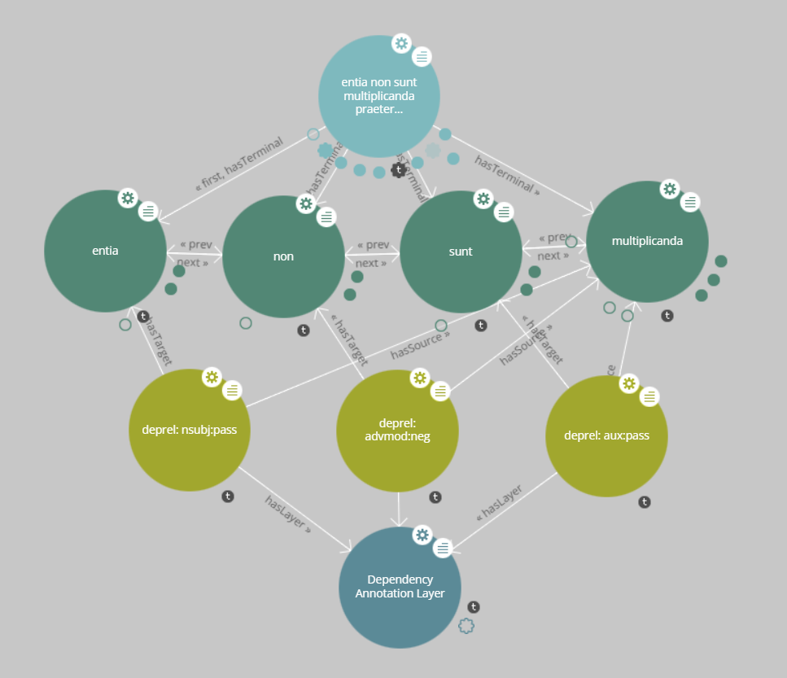
Syntax
Dependency Annotation Layer
Each node is a deprel that connects source (head) to target (dependent)

Slide 20
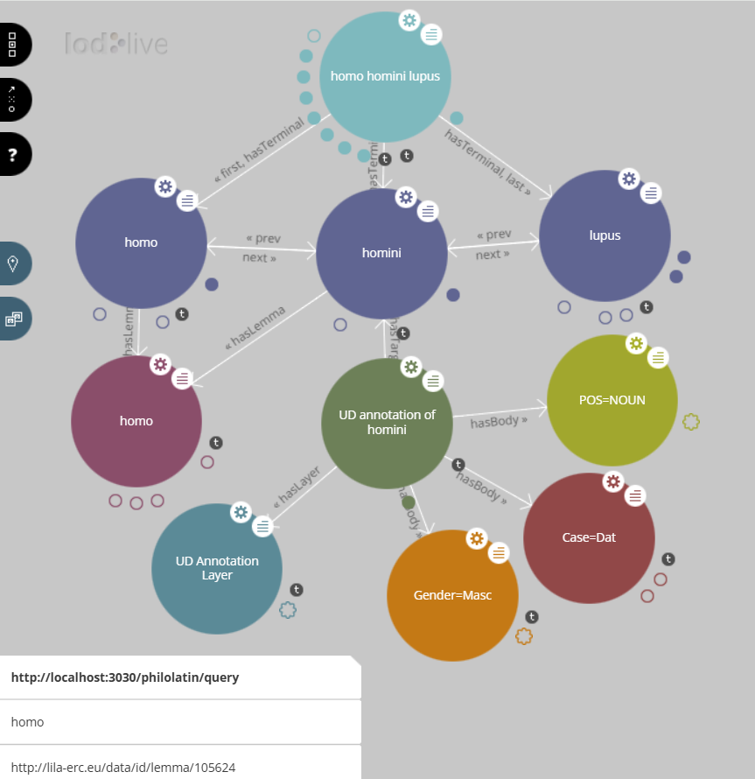
POS and morphology
UD Annotation Layer
Each note has the token as target and the POS/ morphological features as body
POS and features are linked to UD definition page
Each token has a lemma connected to LiLa lemma

Slide 21
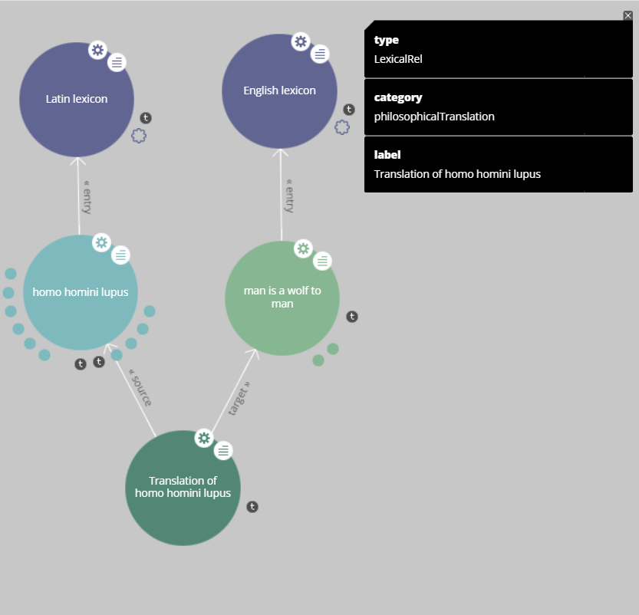
ONTOLEX: LIME and VARTRANS
Each expression is a LexicalEntry of a lexicon
Latin lexicon and English lexicon
Translation as LexicalRel between lexical entries
Translation is reified and it is of category “philosophicalTranslation”

Slide 22
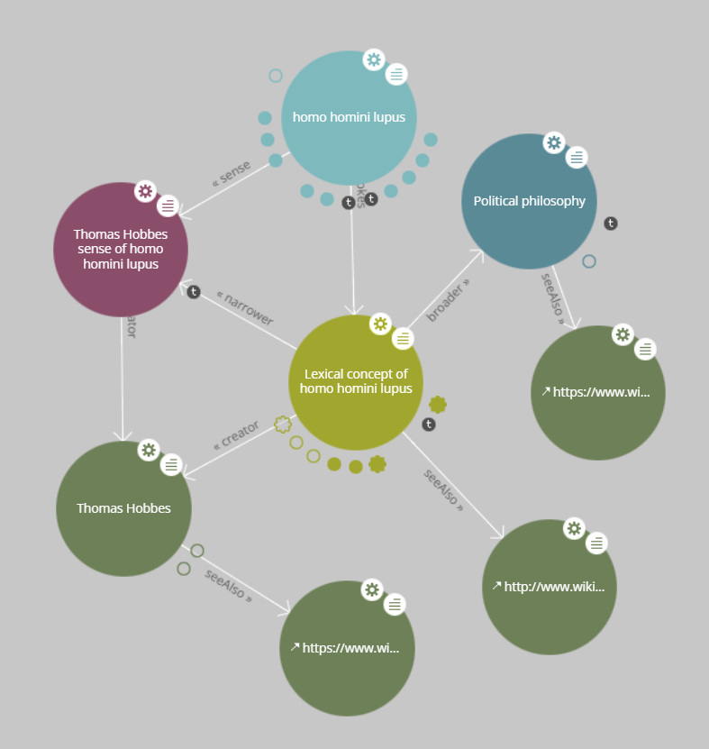
Semantics
Lexical Entry evokes a Lexical Concept
Branch of philosophy as broader concept
Links to entry, philosopher and branch in Wikidata
Interpretations by philosophers are lexical senses

Slide 23
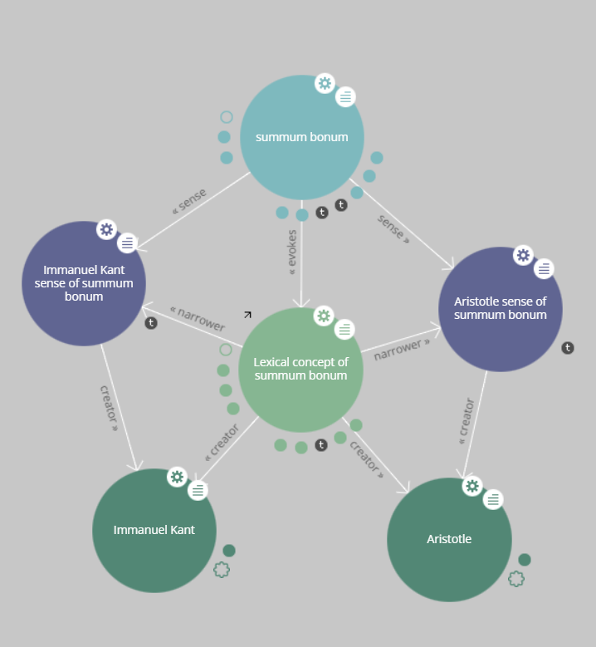
Interpretations
Different interpretations by philosophers as lexical senses
Narrower concepts of lexical concept
Philosopher as dc:creator

Slide 24
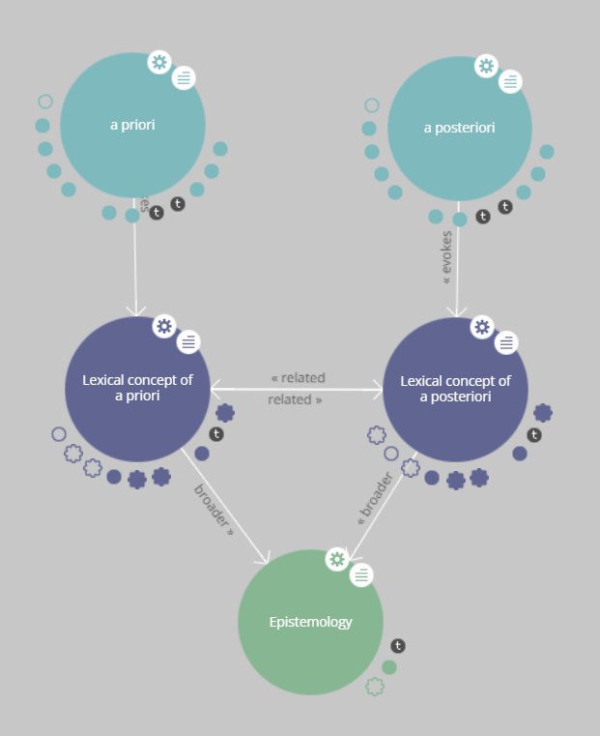
Related concepts
SKOS:related

Slide 25
Results

Slide 26
Quantitative results
 | # | SPARQL Query
Number of expressions in each lexicon | 153 | SELECT ?lexicon (COUNT(?philoexprid) AS ?expr_count) WHERE { ?philoexprid rdf:type ontolex:LexicalEntry; lime:entry ?lexiconid . ?lexiconid rdfs:label ?lexicon. } GROUP BY ?lexicon
Number of triples | 19 302 | SELECT ?subject ?predicate ?object WHERE { ?subject ?predicate ?object }
Number of philosophers | 109 | SELECT (COUNT(DISTINCT ?philosopherid) AS ?philosophers) WHERE { ?senseid a ontolex:LexicalSense ; dct:creator ?philosopherid }
Number of senses | 614 | SELECT (COUNT(?senseid) AS ?senses) WHERE { ?senseid a ontolex:LexicalSense . }

Slide 27
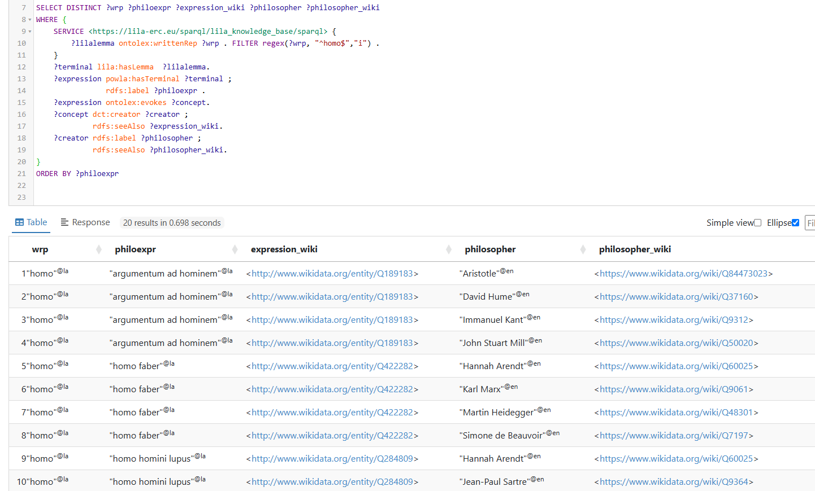
Examples of analysis: From LiLa to philosophy

Slide 28
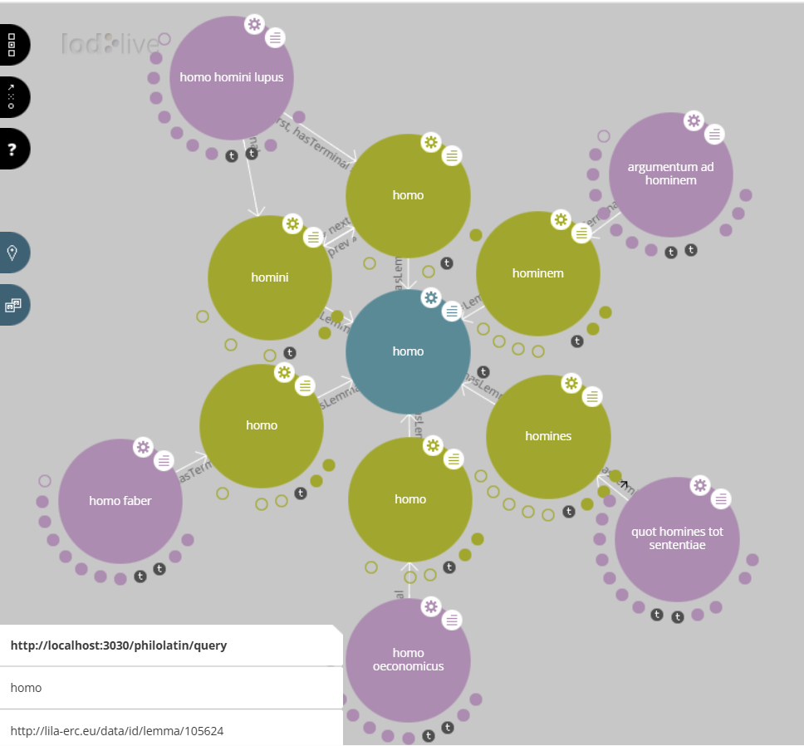
Expressions containing “homo”

Slide 29
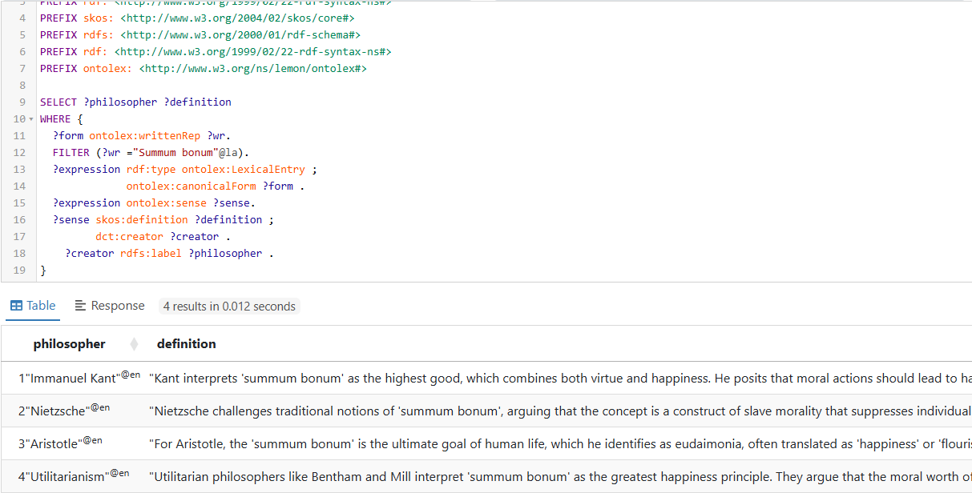
Interpretations of “Summum bonum”

Slide 30
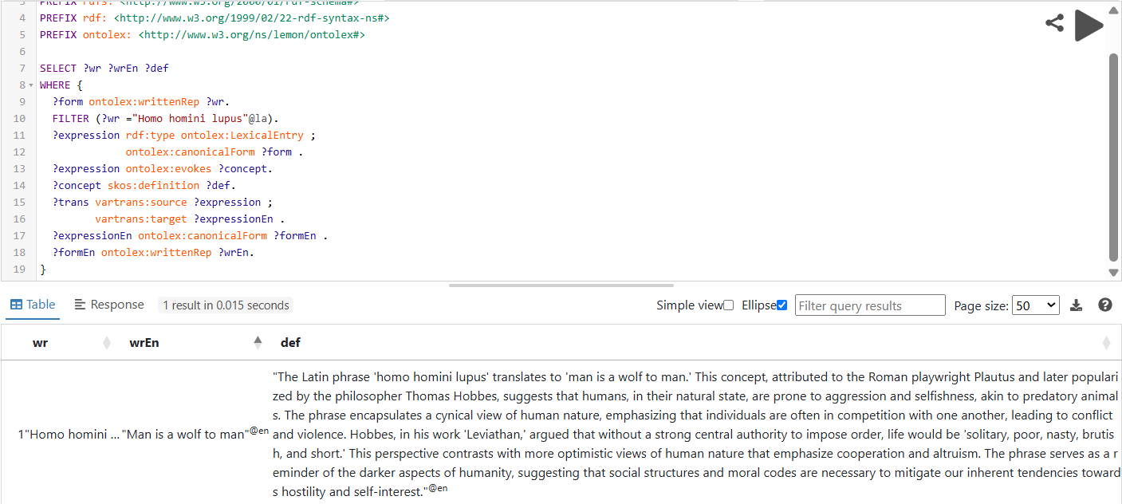
Translation and definition of “Homo homini lupus”

Slide 31
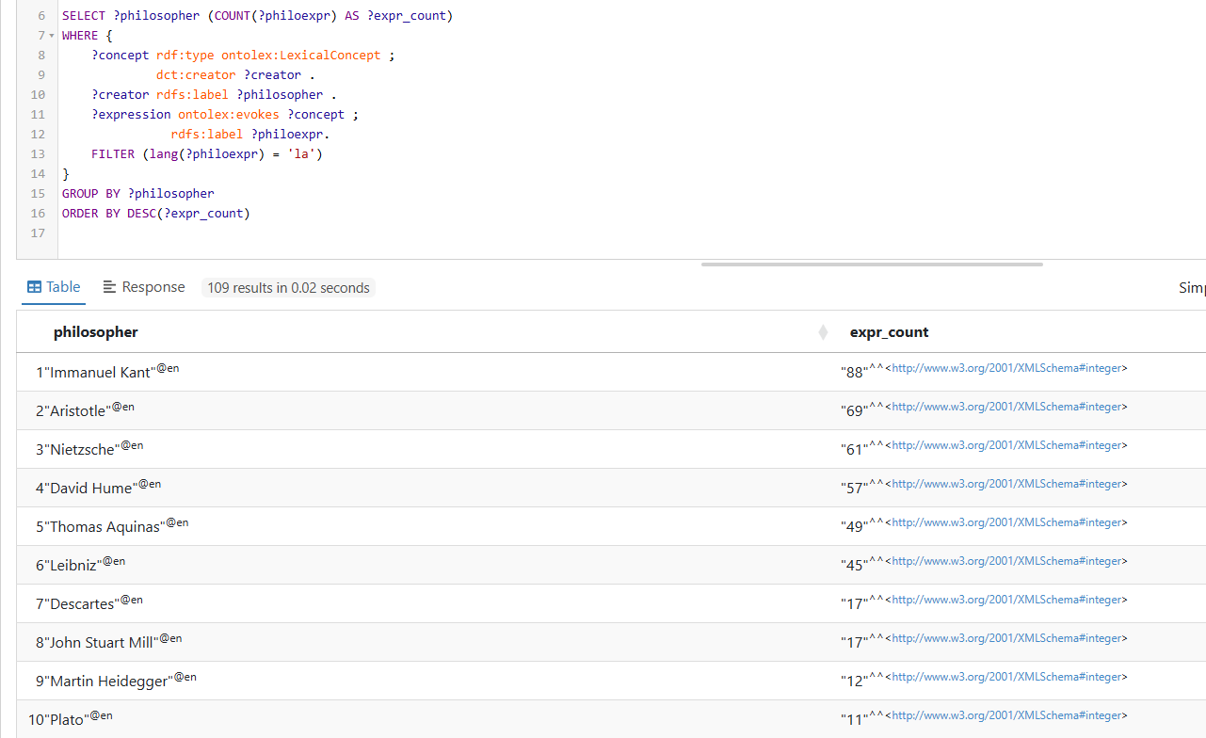
Philosophers connected to most expressions

Slide 32
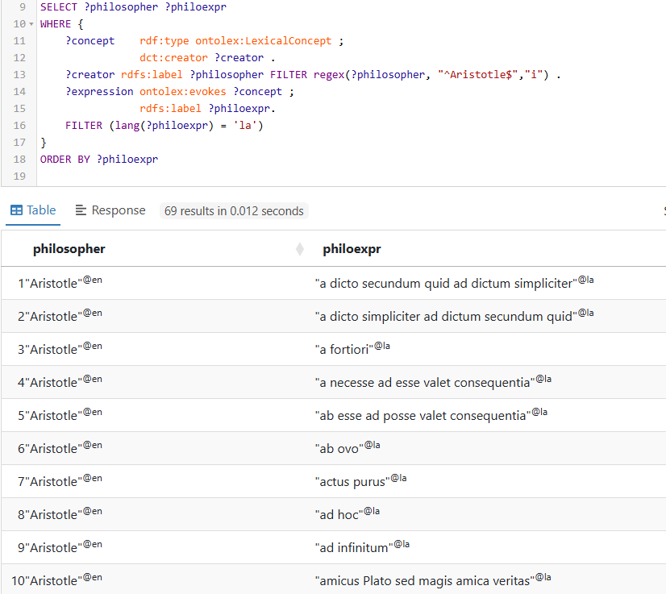
Expressions connected to Aristotle

Slide 33
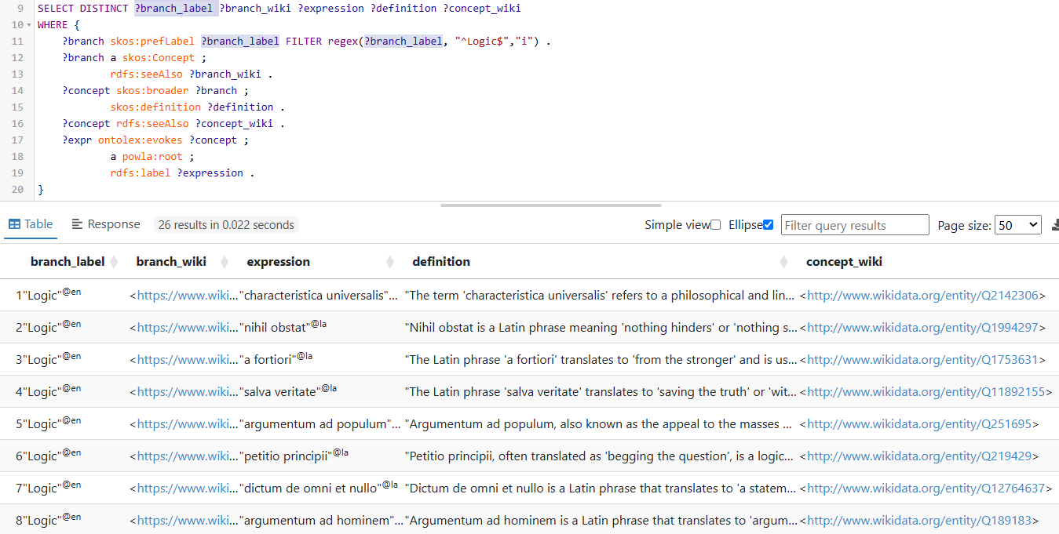
Expressions belonging to “Logic”

Slide 34
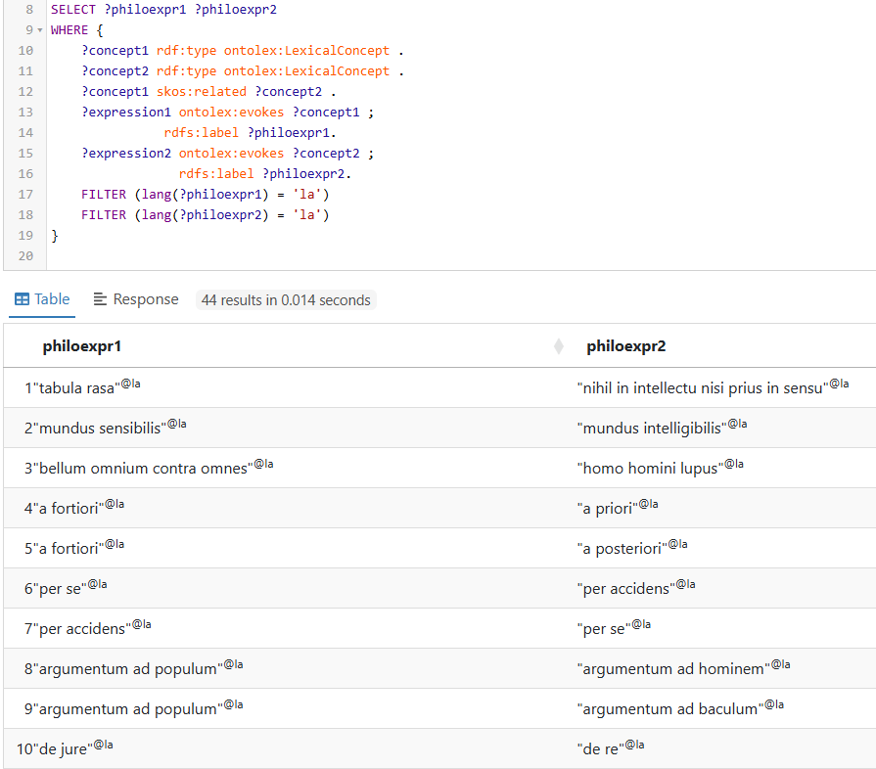
Linked concepts

Slide 35
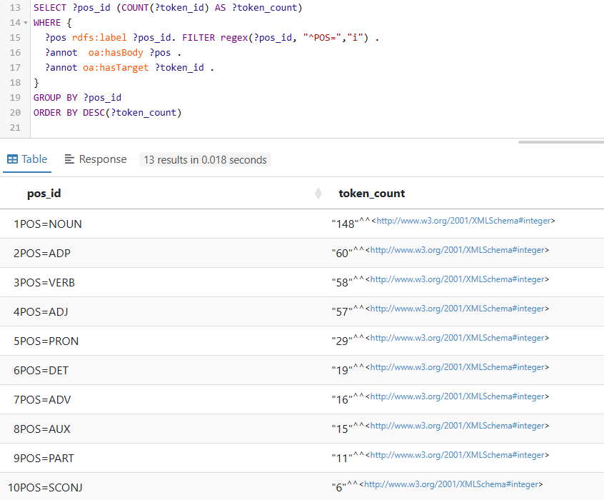
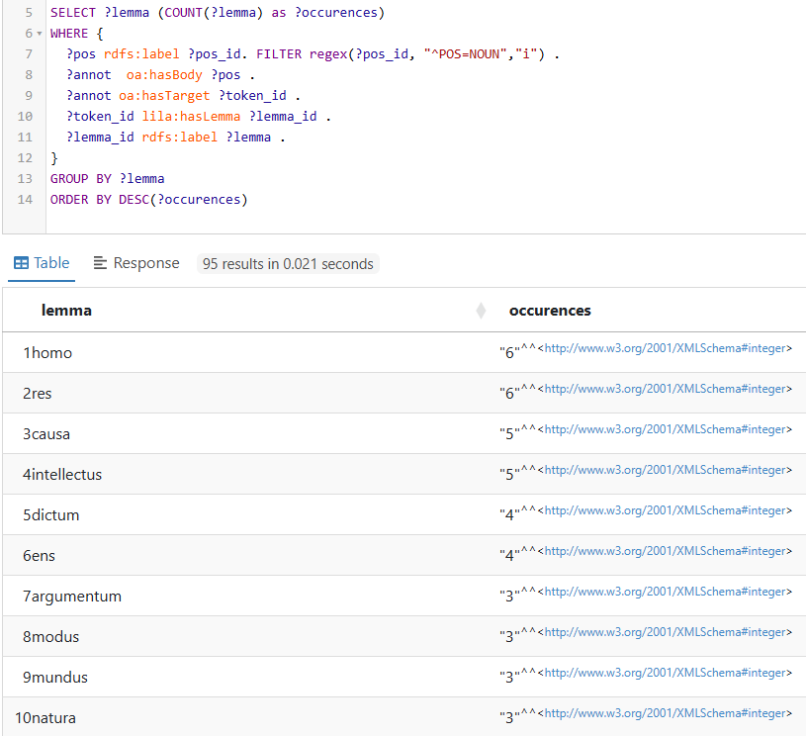
Most frequent POS and Nouns

Slide 36
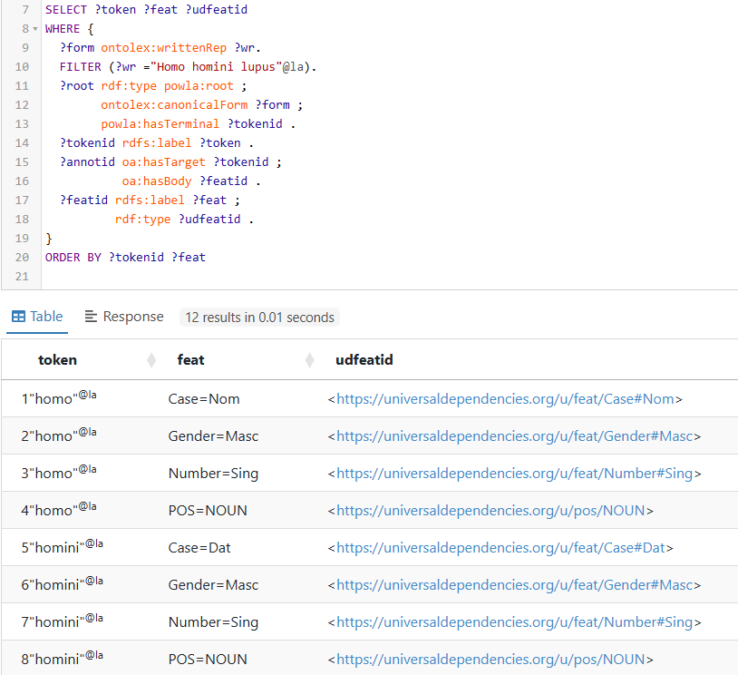
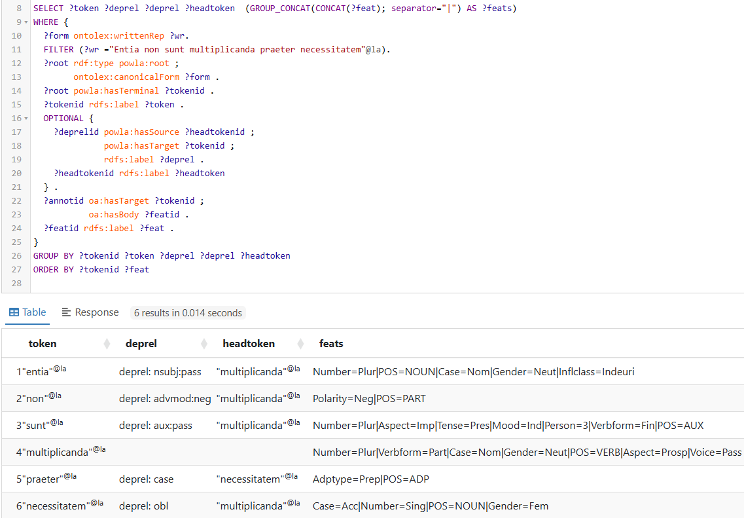
UD annotations

Slide 37
Potential applications in NLP
NER: detect philosophical concepts or thinkers (i.e., annotate entities like “res cogitans” or “Descartes”).
MT: translate Latin philosophical expressions to/from English.
KG construction: build knowledge graphs of philosophical ideas.
WSD: resolve ambiguous terms in philosophy (i.e., disambiguate “Summum bonum” as Kantian vs. Aristotelian).
QA: answer questions like "How does Descartes interpret “Res cogitans”?

Slide 38
Considerations and open questions
The most difficult part was deciding how to model the various interpretations by different philosophers.
I considered them as lexical senses, but how are they linked to the general meaning?
I thought it made sense to consider them narrower concepts than the general meaning, but would it be correct to consider them as lexicalized senses of the lexical concept in the same way intended for Synsets in WordNet?
Could the different interpretations be linked using VARTRANS senseRel?
I did not provide a reference for these lexical senses, because I didn’t have an ontology but only a definition of the sense. Does this follow ONTOLEX best practices?

Slide 39
Conclusion
this project presents a structured and interoperable dataset of Latin philosophical expressions
the resource is modeled using Linked Data standards (ONTOLEX, SKOS, and POWLA).
combines syntactic analysis with semantic and conceptual annotation
can support both students and computational applications
aligns with semantic web principles, enabling integration with external knowledge bases like Wikidata and LiLa.
limits: its use assumes familiarity with RDF, SPARQL, and ontology-based modeling, which may limit accessibility for non-technical users
future work: expand the corpus and develop user-friendly interfaces

Slide 40


Thank you
Giovanna Tonazzo - 5216819
giovanna.tonazzo01@icatt.it

